Slide 1
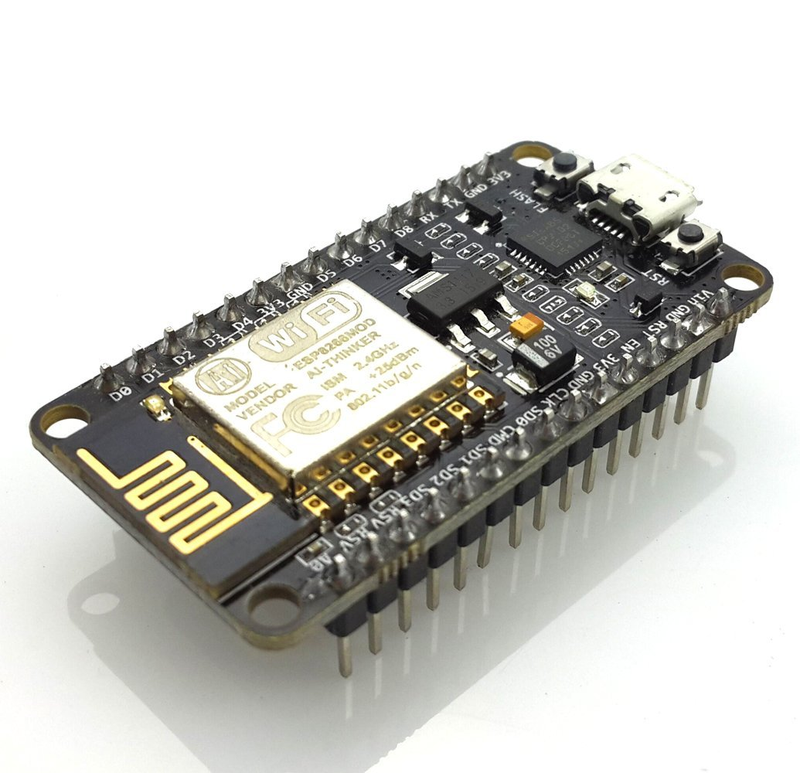
NodeMCU ESP8266 Class

Slide 2
What is the ESP8266?
Microprocessor and WIFI board
Full TCP/IP stack
32-bit RISC microprocessor
16 GPIOs
Less than $4
Perfect for IOT projects

Slide 3
What is the NodeMCU?
Development board for the ESP8266
USB Programmable
Easier to use
More expensive, wouldn’t be used for mass production, just for prototyping

Slide 4
What We’re Building
A simple circuit that controls an LED over WIFI, showing you how to do output over wifi
A simple circuit that read a light sensor (photoresistor) over wifi, showing you how to read input over wifi
Together these are the basic tasks you’ll want to do with an IOT project, input and output over the air

Slide 5
What’s in the kit?
NodeMCU ESP8266 Development Board
MicroUSB Cord
Breadboard
LED
Photoresistor
10K Resistor
4 Jumper Wires

Slide 6
How to program it?
A few different ways supported by the community
Some people use LUA programming language
Community and company put out IDE’s
We’ll be using C++ and Arduino IDE for simplicity

Slide 7
Setting Up The Environment
Install Arduino IDE
Google “Install Arduino IDE”
Download the installer & run it
Setting Up ESP8266 for Arduino IDE
File -> Preferences
Additional Boards URL: http://arduino.esp8266.com/stable/package_esp8266com_index.json
Tools -> Boards -> Boards Manager
Search “ESP8266” & Install the board
Select the board
Tools -> Boards -> NodeMCU 1.0 (ESP-12E Module)
Select COM Port
Tools -> Port -> COM#

Slide 8
Setting Up The Environment Continued
Change Serial Monitor BAUD Rate
Tools -> Serial Monitor
From new window: 115200 BAUD
This allows NodeMCU to communicate with your computer

Slide 9
Hooking up the Circuit
LED Circuit
Put the NodeMCU at the top of the breadboard
Connect GND to the right – rail
Connect 3v3 (row 10) to row 20
Connect LED’s anode (long pin) to row 20, and the cathod to the – rail
Connect Pin D7 (row 6) to row 27
Photo resistor Circuit
Connect the photoresistor to row 27 and row 29
Connect pin A0 (row 15) to row 29
Connect the 10K resistor to row 29 to the - rail

Slide 10
The Code
Put in a folder called NodeMCU_IO_Tutorial
https://github.com/tinkerandbuild/nodemcu_tutorial

